Slide 1

Appian Tips & Tricks Webinar: Smooth SAILing… …with Appian Interface Designer
Alison Cowley, Product Manager, Interface Designer
August 14, 2014

Slide 2
The Next Tips & Tricks Seminar
Achieving the Optimal End User Experience
Featuring Appian Product Manager, Jane Hill
Tuesday, September 9
12:00 PM – 1:00 PM EDT

Slide 3
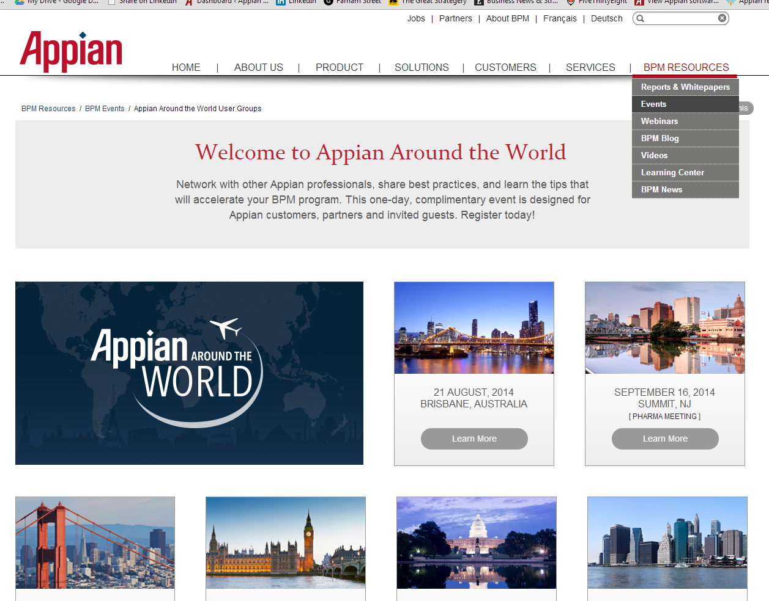
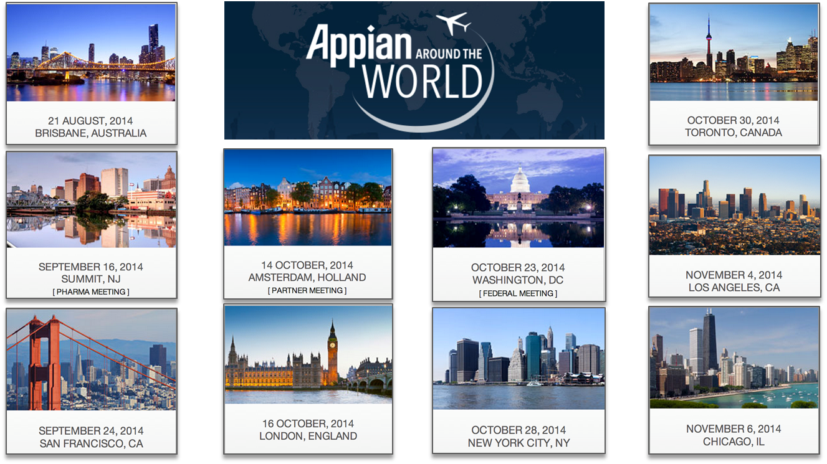
Appian Around the World

Slide 4
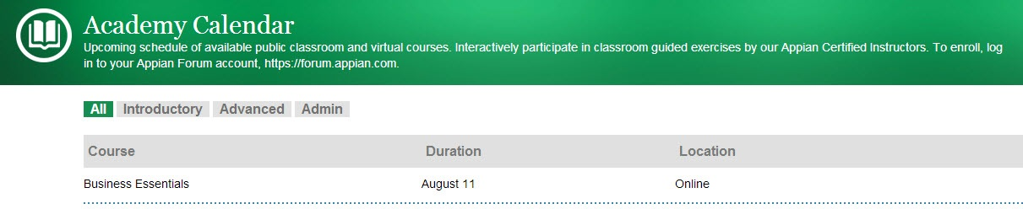
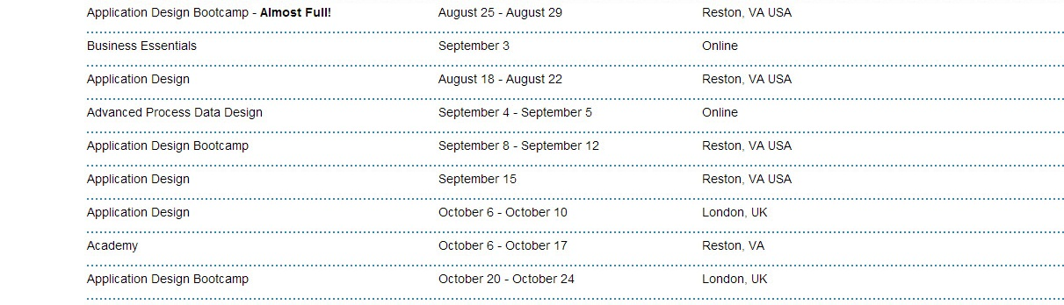
Upcoming Training Sessions

Slide 5
High-Level Agenda
SAIL Overview
Smooth SAILing with Interface Designer
Overview
Demos!
Questions and Answers

Slide 6
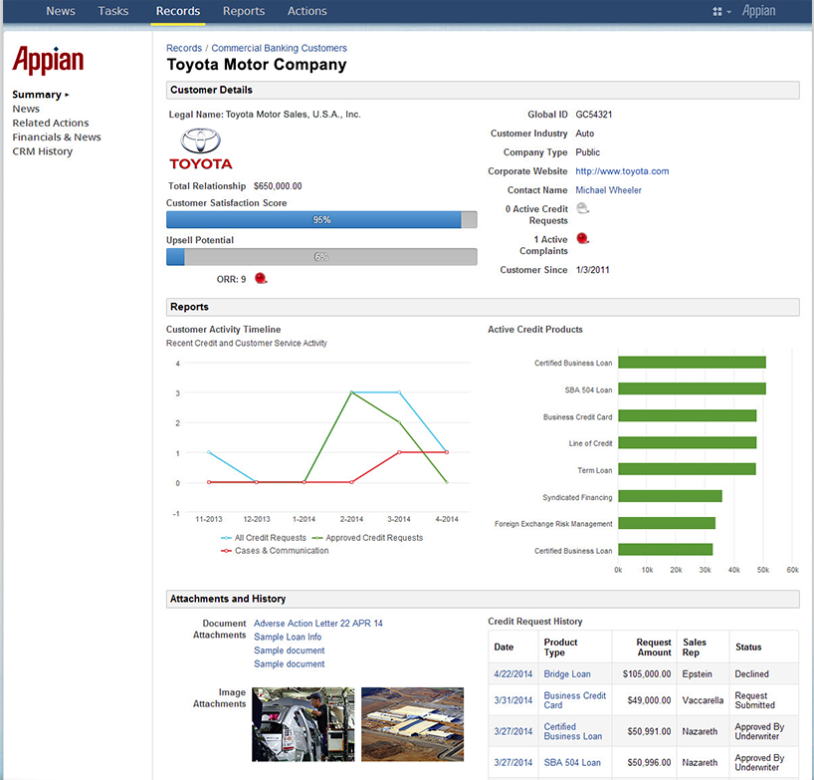



Rich, Interactive Interfaces

Slide 7
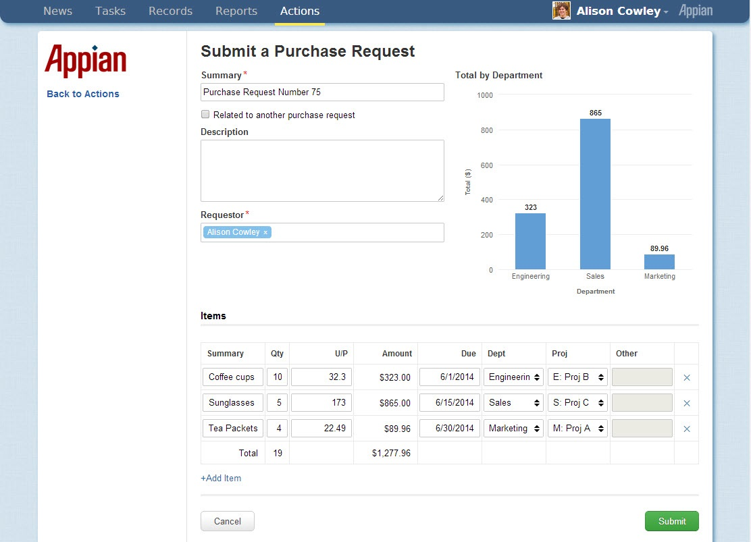
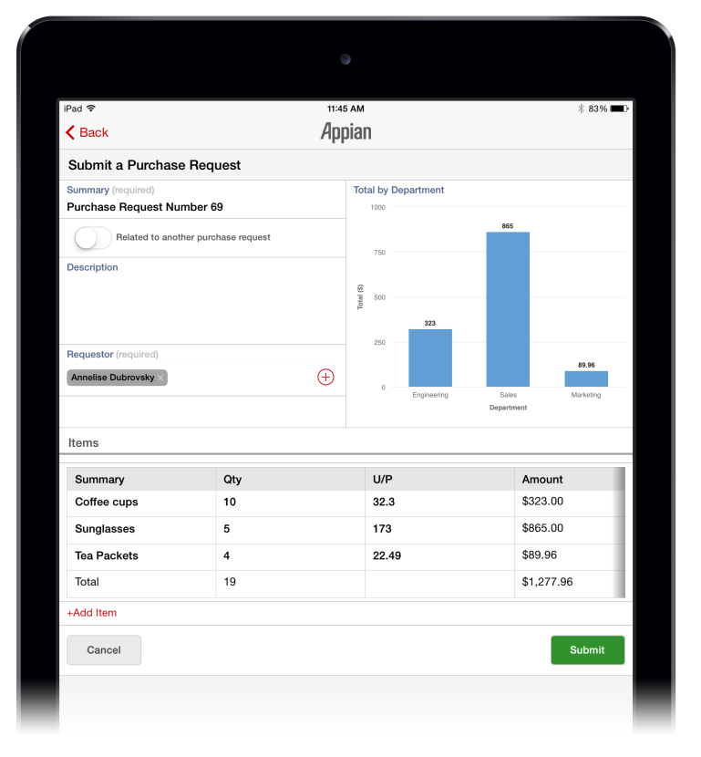
Responsive& Portable Interfaces

Slide 8

This is SAIL
End User
Web App
End User
iOS App
End User Android App
Application
Designer
Interface
Designer
Process
Designer
Data
Designer

Slide 9

Introducing Our Speaker
Alison Cowley
Product Manager
Focus on Interface Designer
Background in IT, engineering
Enjoys:
Coding
Baking
(American) Football!

Slide 10
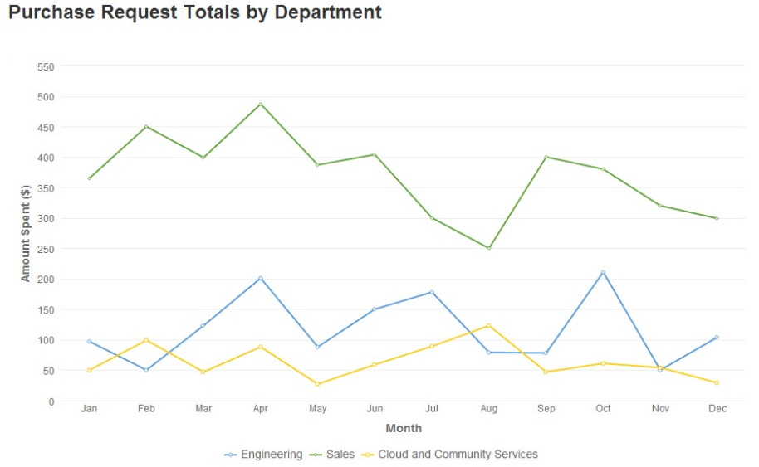
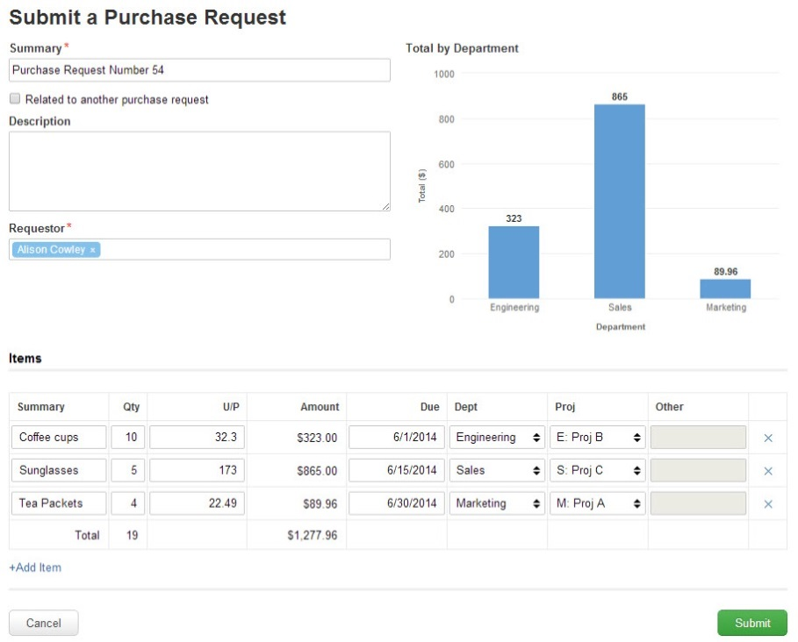
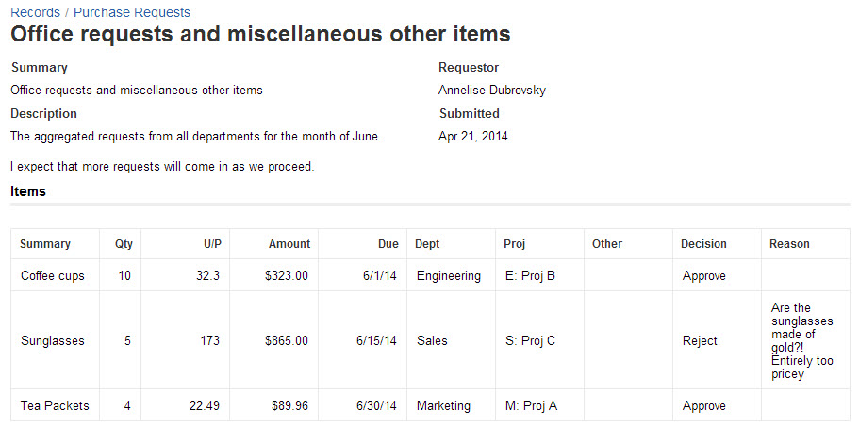
Unified Designer for all Interfaces
Reports
Forms
Records

Slide 11
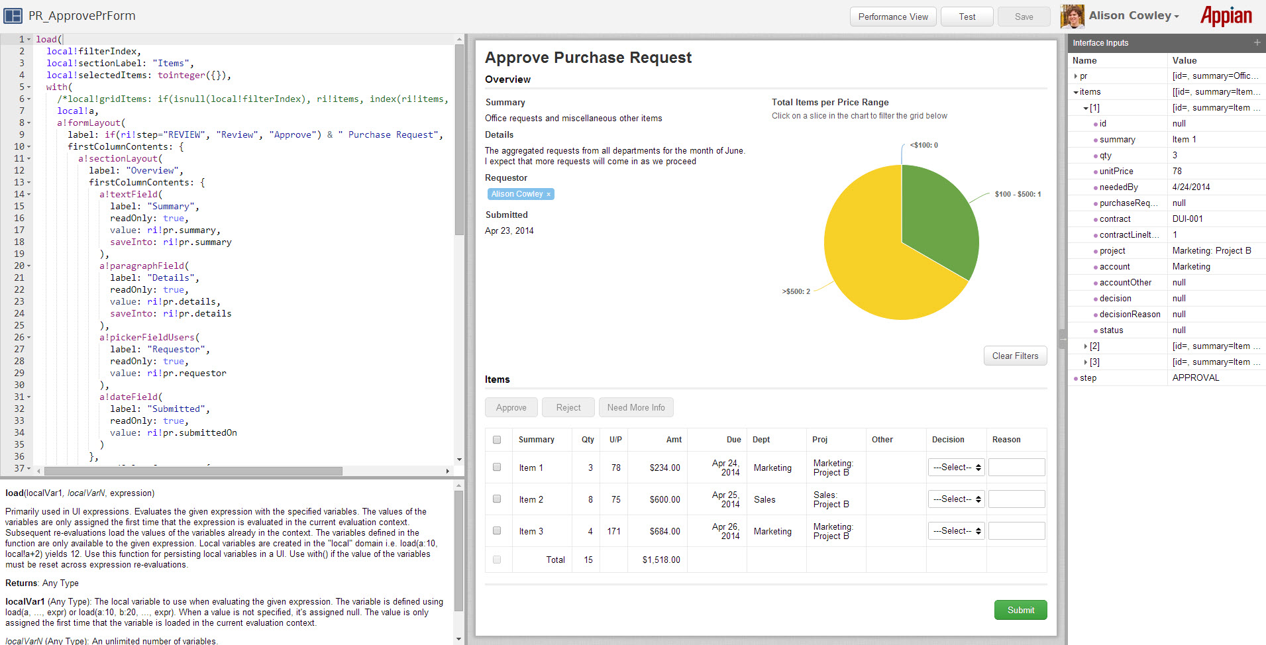
Interface Designer Panes
Design
Live
Data

Slide 12
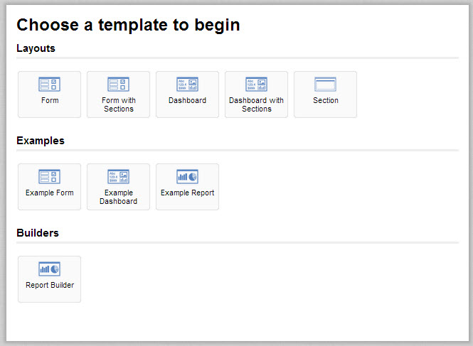
Getting Started with Templates

Slide 13
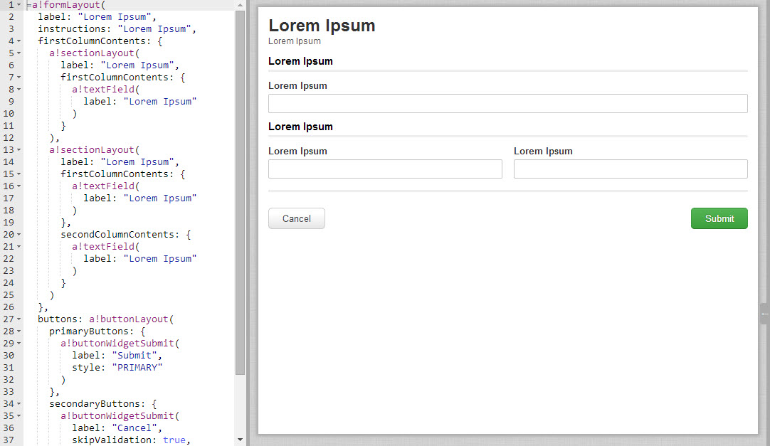
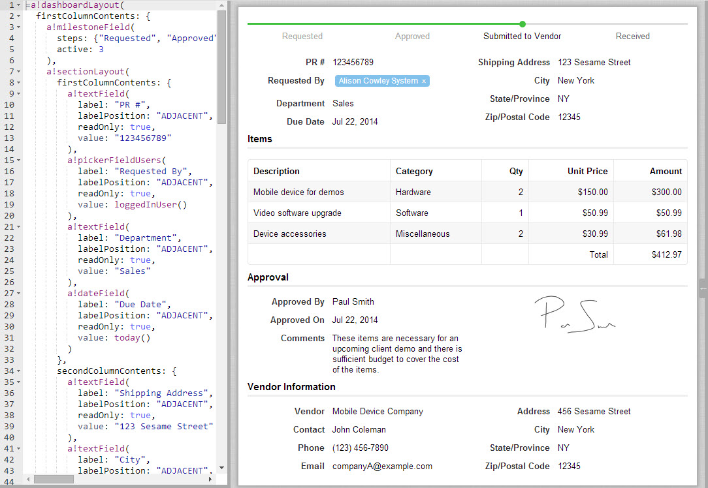
Getting Started with Templates
Layouts
Examples

Slide 14

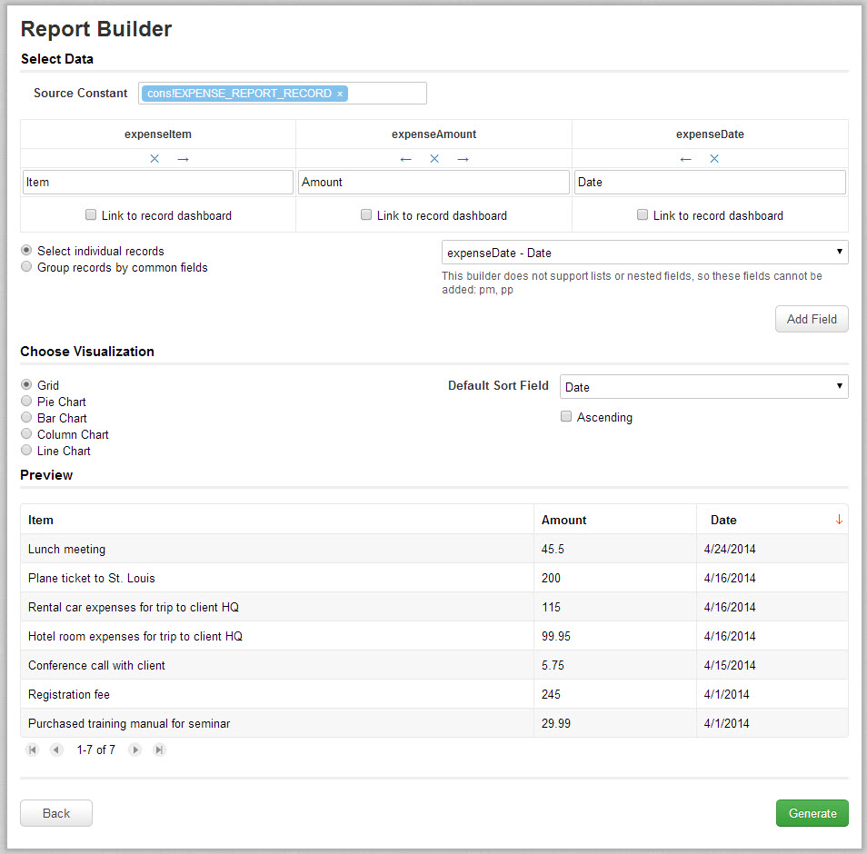
Report Builder for Charts and Grids

Slide 15
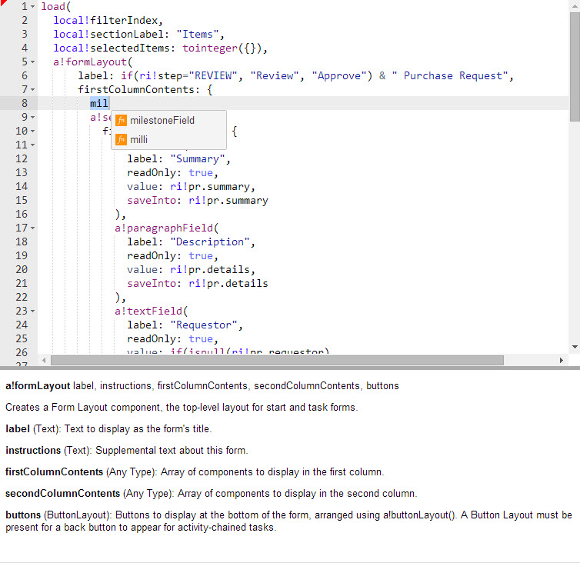
Editing the Interface Definition
Syntax Highlighting
Autosuggest
Inline Documentation

Slide 16
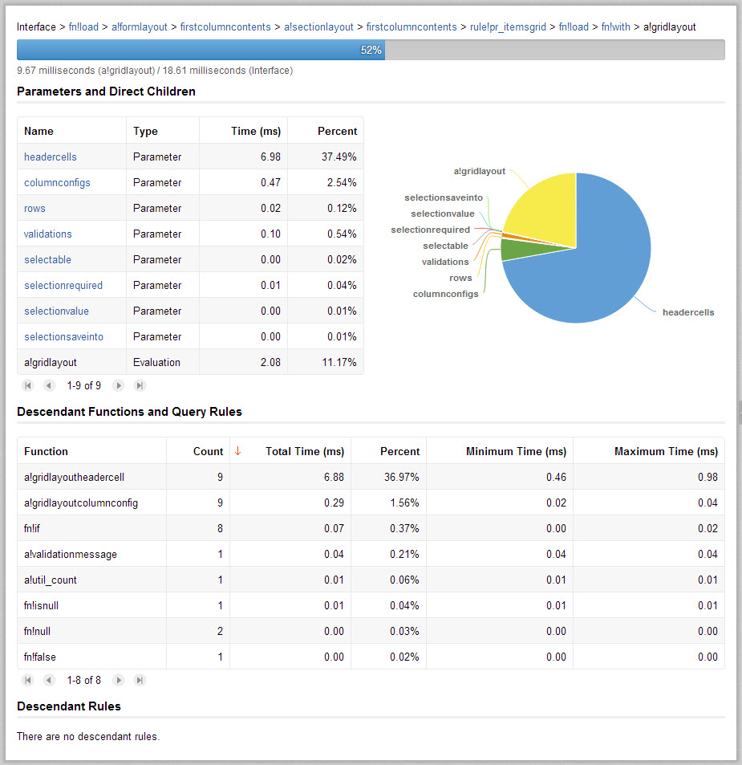
Optimizing Interface Performance

Slide 17
Interface Designer Demo

Slide 18
Additional Resources
Appian 7.6 Resources
Download
Documentation
SAIL Resources
Interface Designer
SAIL Design
SAIL Components
SAIL Recipes
SAIL Tutorial
General Product Resources
Tips & Tricks webinar
Product Webinar

